Slide 1
Geog 714
Data analysis
Today: Longitudinal regression analysis and univariate time series

Slide 2
Longitudinal regression analysis
Longitudinal regression analysis
Measurements of some phenomena, y_{i}, over time
Time and some other known/suspected factors that are thought to explain y_{i}
Interest in ‘explanation’; what explains variation over time? Is it random, and if not, can I predict where it is going?

Slide 3
Examples
y_{i} | t | x1_{i} | x2_{i}
4.2 | 1 | 45.89 | -1.2
3.9 | 2 | 34.98 | 0.5
3.2 | 3 | 32.22 | -0.1
... | ... | ... | ...
Carbon flux as a function of soil temperature, air temperature, precipitation and time
Unemployment in a city rate as a function of economic, social factors, cultural factors and time
Effect of drug treatment on a panel of subjects in RCT*
Notes:
Records are observations are moments in time

Slide 4
Longitudinal regression analysis
Repeated measures problem
When there are repeated measures of subjects, attributes may ‘cluster’ at the subject level
This presents statistical challenges
Often requires some statistical accounting; e.g., repeated measures, mixed models, autocorrelated error structure, etc.
y_{i} | t | subject_{i} | x1_{it}
4.2 | 1 | 1 | -1.2
3.9 | 2 | 1 | 0.5
3.2 | 1 | 2 | -0.1
2.7 | 2 | 2 | 1.4
3.3 | 1 | 3 | -1.3
... | ... | ... | ...

Slide 5
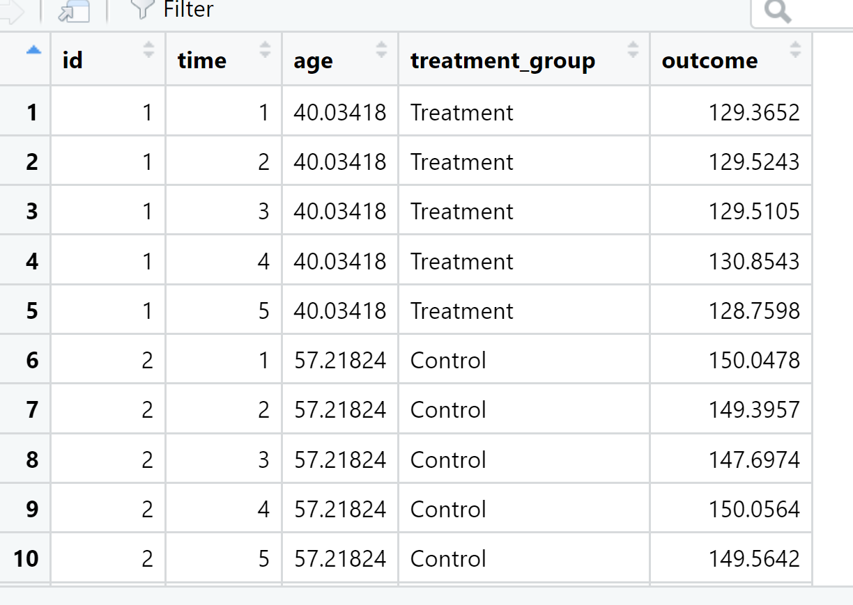
Longitudinal regression analysis
library(lme4)
set.seed(8675309)
n <- 100 #number of individuals
n_per <- 5 #number of measurements per individual
#generate data
id <- rep(1:n,each=n_per)
time <- rep(1:n_per,times=n)
age <- rnorm(n,mean=50,sd=10)[id] #awesome example of indexing!!!
treatment_group <- rep(sample(c('Control','Treatment'),n,replace=TRUE),each=n_per)
ind_effect <- rnorm(n)[id] #awesome example of indexing!!!
outcome <- 120+0.5*age-10*(treatment_group=='Treatment')+ind_effect+rnorm(n*n_per)
#combine into a data frame
df <- data.frame(id, time, age, treatment_group, outcome)
model <- lmer(outcome~time+age+treatment_group + (1|id),data=df)
summary(model)

Slide 6
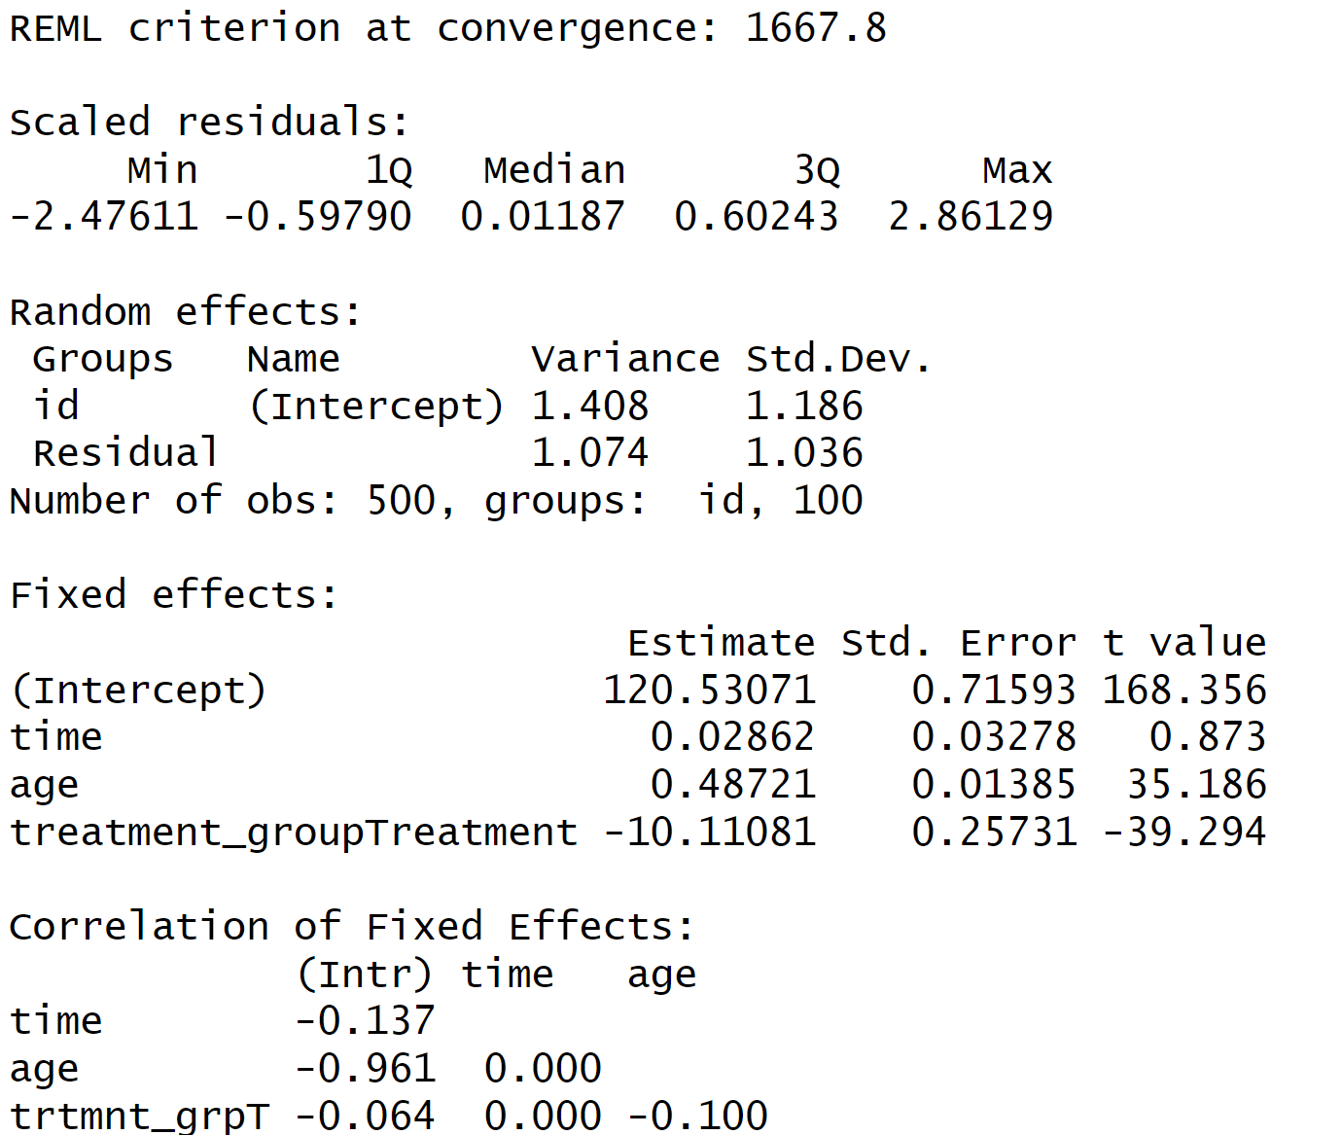
Longitudinal regression analysis
‘clustering’ at the subject level
accounts for the fact that subjects are correlated to themselves over time
regression coefficients

Slide 7
Univariate time series
Univariate time series analysis
Measurements of some phenomena, y_{i}, over time
Model y_{i} as a function of time structures like periodicity, trend and autocorrelation
When prediction matters, and no other forecasting data are available

Slide 8
Examples
y_{i} | t
4.2 | 1
3.9 | 2
3.2 | 3
... | ...
Stock market activity (price, volume, etc.)
Influenza diagnoses
Sales of a product
Weather trends

Slide 9

ARIMA models
Univariate time series modelling by finding three components:
Autoregressive (AR)
Correlation between observation and previous observation
Integrated (I)
How much differencing is required to the series over time (e.g., secular trend)
Moving average
Number of lagged forecast errors

Slide 10
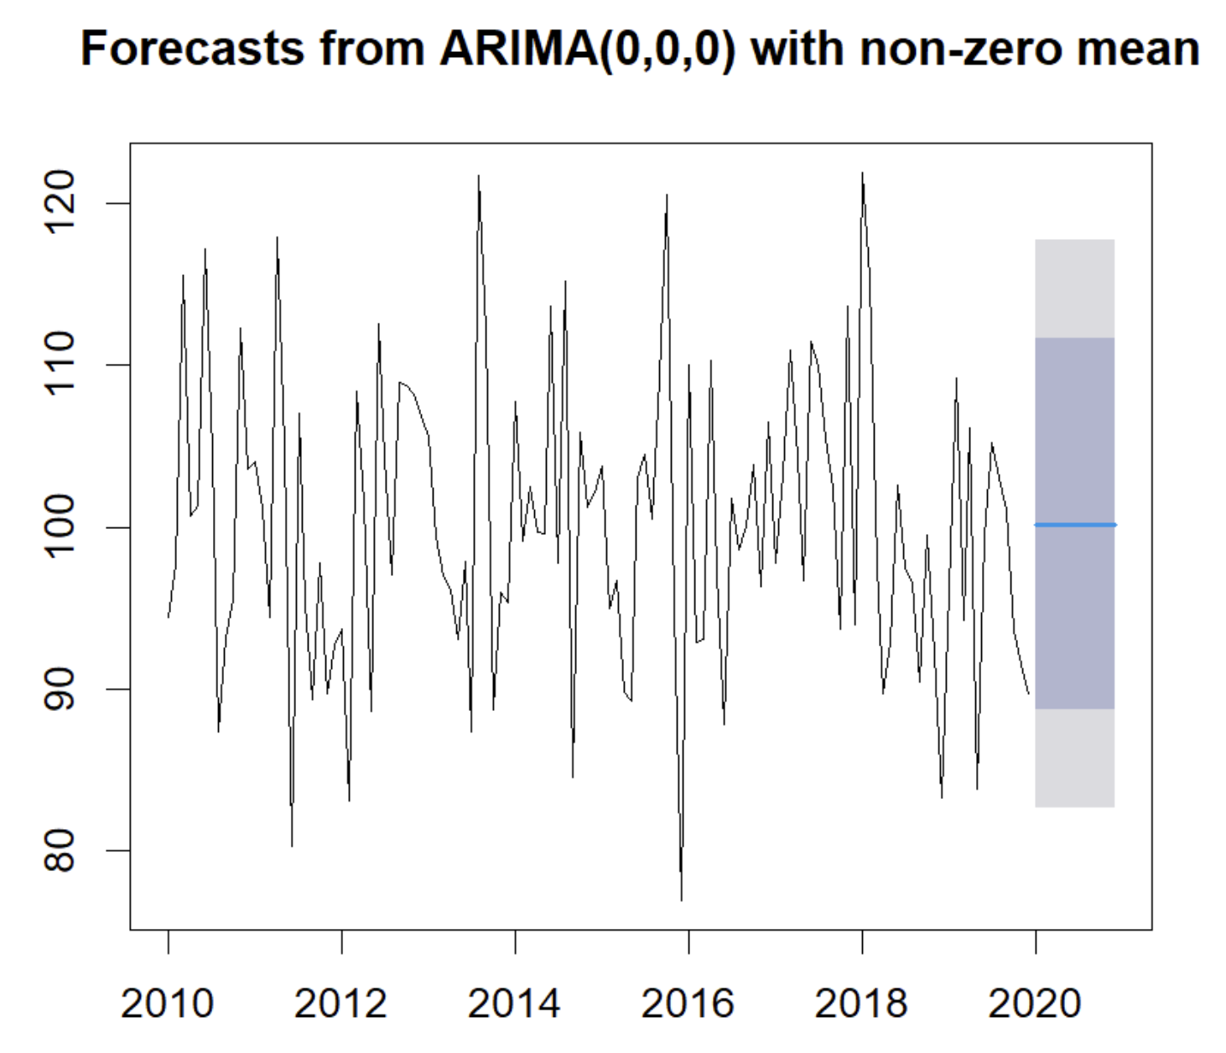
Univariate time series
install.packages("forecast")
library(forecast)
set.seed(8675309)
ts_data <-ts(rnorm(120,mean=100,sd=10),frequency=12,
start=c(2010, 1))
ts_decomp<-decompose(ts_data)
plot(ts_decomp)
fit <- auto.arima(ts_data)
#forecast next 12 months
forecasted_values <- forecast(fit, h = 12)
plot(forecasted_values)

Slide 11
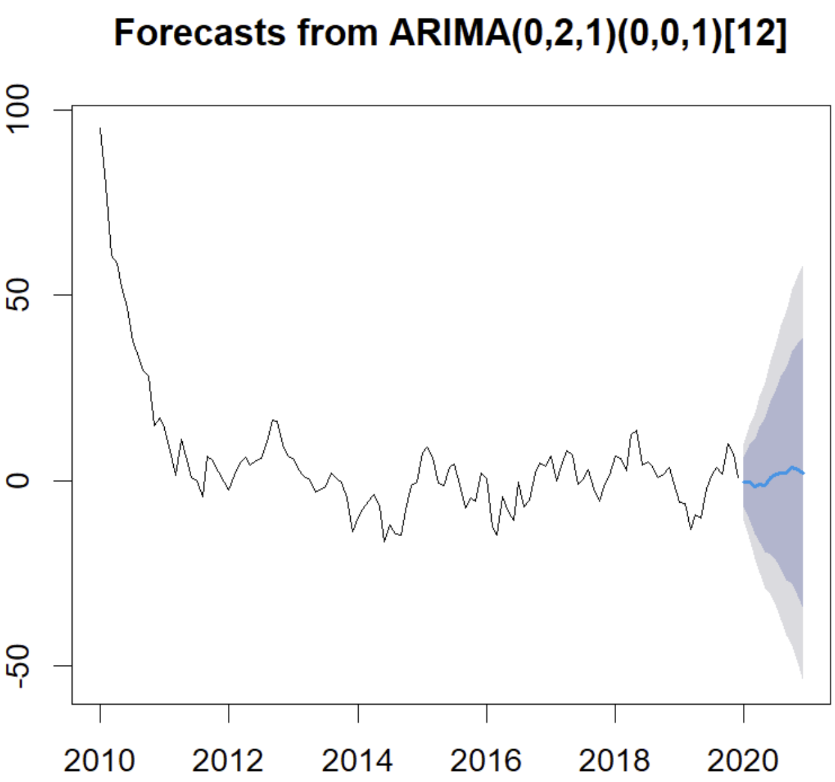
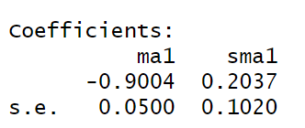
Univariate time series
set.seed(8675309)
n <- 120
phi <- 0.8 #coefficient for the AR term, indicating strong autocorrelation
sigma <- 5 #standard deviation of the error term
#Generating the AR(1) process
ar_data <- rep(0,n)
ar_data[1] <- rnorm(1,mean=100,sd=sigma) #first value of the series
for (t in 2:n) {
ar_data[t] <- phi * ar_data[t-1] + rnorm(1,mean=0,sd=sigma)
}
ts_data <- ts(ar_data,frequency=12,start=c(2010,1))
ts_decomp <- decompose(ts_data)
plot(ts_decomp)
fit <- auto.arima(ts_data)
forecasted_values <- forecast(fit,h=12) #forecasting the next 12 months
plot(forecasted_values)
Moving average
Autocorrelation
Differencing/ detrending
Seasonal moving average

Slide 12
Univariate time series vs. longitudinal regression analysis
Both involve time, but univariate means all information available is assumed to be in the measurement over time
An attempt to parameterize a model based on its inherent or latent structure rather than measured independent variables
Model periodicity and autocorrelation without knowing the periodicity or autocorrelation ahead of time

Slide 13
Univariate time series vs. longitudinal regression analysis
Longitudinal regression analysis
Understand the factors that explain the pattern in the dependent variables
Understandable model
Mind driven, time consuming
Needs human thinking
Univariate time series analysis
Prediction
Maybe discovering structure that was previously unknown
Black box
Forecasting, routine work
Less human thinking required
Time series analysis with other predictors
Prediction
Maybe discovering structure that was previously unknown
Black box
Forecasting, routine work
Added variables at various stages of analysis
Less human thinking required, but have to choose the variables to include

Slide 14
Exogenous data and change points
In your assignment, you will mix univariate with exogenous variables
Many ways to do this
You’ll also use a ‘changepoint’ detection algorithms
Changepoint analysis allows you to determine if there is a shock/change in a time series

